Slide 1
LECTURE THREE – SAFETY AND MEDICAL DEVICES (PART TWO)
LAW2291_2024
Contemporary Issues in Biolaw (24/25)

Slide 2
0.0
Continuation of last lecture
We go through every part of the MDR (yay)!
Downside: Dry lecture. Do not expect to know everything, but get the general picture, and keep in mind this is about AI, cybersecurity, and safety. You are not here to learn everything, even a whole full year course on the MDR would not teach you that.

Slide 3
0.1 Structure (again)
Chapter I Scope etc., Chapter II obligations/marking details, Chapter III identification/traceability of devices etc., Chapter IV Notified Bodies, Chapter V classification/conformity assessment, Chapter VI clinical evaluation/clinical investigations, Chapter VII post-market surveillance etc., Chapter VIII cooperation and coordination, Chapter IX confidentiality/data protection etc., Chapter X (final provisions)

Slide 4
1.0 Intention
General for Product Regulation (but be careful)
Art 2(1) from last time, and Art 5(1) and 5(2)
Relies on public sources and applications
Why is this important?

Slide 5
1.1 Intention
If the manufacturer does not intend for the system (AI or otherwise) to be a medical device, it does not fulfil the initial criterium.
Grey area.
In my paper I suggest direct and indirect intention as distinctions

Slide 6
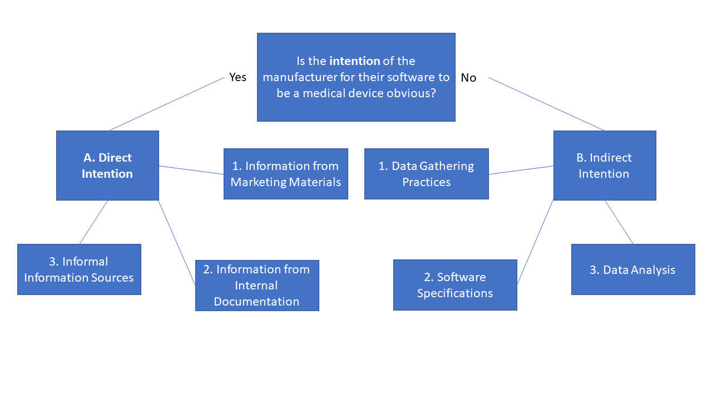

Slide 7
1.2
This is an academic exercise – but it is there to prevent circumvention, and possible inclusion of de facto medical devices
Possible due to general enforcement powers of authorities, though this is not literal

Slide 8
2.0 Manufacturer
Some of them:
The system of risk management (Article 10(2)). (1 paragraph)
The system for quality management (Article 10(9)).
Sole responsibility for devices (Article 10(1)(12)(13)(14)).
A system for financial responsibility (Article 10(16)).
Annex I specific obligations.
My opinion did not change since 2021.

Slide 9
2.1
We cannot read through entirety of Article 10 here, but..
10(9) (Quality Management):
Manufacturers shall ensure that procedures are in place to keep series production in conformity with the requirements of this Regulation. Changes in device design or characteristics and changes in the harmonised standards or CS by reference to which the conformity of a device is declared shall be adequately taken into account in a timely manner. Manufacturers of devices, other than investigational devices, shall establish, document, implement, maintain, keep up to date and continually improve a quality management system that shall ensure compliance with this Regulation in the most effective manner and in a manner that is proportionate to the risk class and the type of device.

Slide 10
2.2 Sole Responsibility
Repeated in several places, 10(1)(12)(13)(14) and more depending on interpretation
General for products – for MDs much sharper
10(14), paragraph 2:
If the manufacturer fails to cooperate or the information and documentation provided is incomplete or incorrect, the competent authority may, in order to ensure the protection of public health and patient safety, take all appropriate measures to prohibit or restrict the device's being made available on its national market, to withdraw the device from that market or to recall it until the manufacturer cooperates or provides complete and correct information.

Slide 11
2.3 System for Financial Responisbility
Art 10(16):
Natural or legal persons may claim compensation for damage caused by a defective device in accordance with applicable Union and national law.
Manufacturers shall, in a manner that is proportionate to the risk class, type of device and the size of the enterprise, have measures in place to provide sufficient financial coverage in respect of their potential liability under Directive 85/374/EEC, without prejudice to more protective measures under national law.
Old Product Liability Directive

Slide 12
2.4 Annex I
Whole text is worth reading!
Connects closely with last lecture – hazards etc.
Must be fulfilled – hard requirement
What about AI?

Slide 13
Chapter I(1):
Devices shall achieve the performance intended by their manufacturer and shall be designed and manufactured in such a way that, during normal conditions of use, they are suitable for their intended purpose. They shall be safe and effective and shall not compromise the clinical condition or the safety of patients, or the safety and health of users or, where applicable, other persons, provided that any risks which may be associated with their use constitute acceptable risks when weighed against the benefits to the patient and are compatible with a high level of protection of health and safety, taking into account the generally acknowledged state of the art.

Slide 14
Chapter I(4):
Risk control measures adopted by manufacturers for the design and manufacture of the devices shall conform to safety principles, taking account of the generally acknowledged state of the art. To reduce risks, Manufacturers shall manage risks so that the residual risk associated with each hazard as well as the overall residual risk is judged acceptable. In selecting the most appropriate solutions, manufacturers shall, in the following order of priority:
Eliminate or reduce risks as far as possible through safe design and manufacture;
where appropriate, take adequate protection measures, including alarms if necessary, in relation to risks that cannot be eliminated; and
provide information for safety (warnings/precautions/contra-indications) and, where appropriate, training to users
Manufacturers shall inform users of any residual risks.

Slide 15
Chapter I(5):
In eliminating or reducing risks related to use error, the manufacturer shall:
reduce as far as possible the risks related to the ergonomic features of the device and the environment in which the device is intended to be used (design for patient safety), and
give consideration to the technical knowledge, experience, education, training and use environment, where applicable, and the medical and physical conditions of intended users (design for lay, professional, disabled, or other users)

Slide 16
3.0 Overview and Notified Bodies and Authorities
Process for MDs:
Design <-> application procedures
Application <-> testing and notified bodies
Notified body approval <-> authority approval
Authority approval <-> setting up infrastructure for sale etc.
Sales and services <-> continuous quality and risk management
Sales <-> end-of-life measures and agreements as needed
Authorities have full power at any stage necessary

Slide 17
3.1 Authorities
Right to request documentation and punish the manufacturer if they do not cooperate (Article 10(14)).
Market surveillance activities (Article 93).
Evaluation of devices suspected of presenting an unacceptable risk or other non-compliance (Article 94).
Procedure for dealing with devices presenting an unacceptable risk to health and safety (Article 95).
Other non-compliance (Article 97)
Overview from 2021.

Slide 18
3.2 Notified Bodies
Chapter IV
Art 36 – basic requirements
Art 39 – management of tasks and teams
Full freedom?
Private and/or public
Art 42 – notification structure

Slide 19
4.0 Final Comments
Certification – Chapter III
Overlap with Annex I in the AIA (second time)

Slide 20
